Slide 1
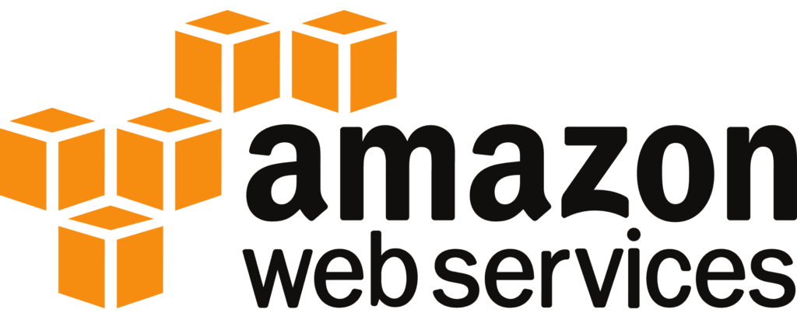

Relational Database Service

Slide 2


AGENDA
What is RDS?
Supported Database Engines
Key Features of RDS
Benefits
Pricing Models in RDS
High Availability with Multi-AZ in RDS
Backup and Recovery
Security in RDS
Conclusion

Slide 3
What is RDS?
Relational Database Service
Definition:
RDS is a fully managed database service that automates common database tasks such as backups, patching, scaling, and replication for relational databases.
Purpose:
RDS simplifies the process of setting up, operating, and scaling relational databases in the cloud, freeing up developers and database administrators to focus on application development rather than database management.

Slide 4
“Supported Database Engines (Example from AWS RDS)”
1. Amazon Aurora (compatible with MySQL and PostgreSQL)
2. MySQL
3. PostgreSQL
4. MariaDB
5. Oracle
6. Microsoft SQL Server
Multi-Cloud Services: Similar services are offered by Azure SQL Database and Google Cloud SQL, supporting various relational databases in managed environments.

Slide 5
Key Features of RDS
Fully Managed:
Automated Backups: RDS automates backups of the database, ensuring data protection and disaster recovery.
Automated Patching: Automatically applies security patches and updates to the database engine.
Scaling:
Vertical Scaling: Easily adjust the CPU, memory, and storage based on the workload.
Horizontal Scaling: For some engines (e.g., Amazon Aurora), RDS supports read replicas for horizontal scaling to improve performance for read-heavy applications.

Slide 6
High Availability:
Multi-AZ Deployments: Provides failover support by automatically replicating data to a secondary Availability Zone (AZ) in case of a primary instance failure.
Security:
Encryption at Rest: Data stored on RDS is encrypted using AWS Key Management Service (KMS).
Encryption in Transit: Ensures secure connections between the database and applications using SSL/TLS.
VPC Integration: Databases can be deployed in a Virtual Private Cloud (VPC) for network isolation and fine-grained security control.

Slide 7

“Benefits of RDS”
1. Easy Setup and Management
2. Automated Backup and Restore
3. Scalability
4. High Availability and Reliability
5. Cost-Effective

Slide 8
Pricing Models in RDS
On-Demand:
Pay only for the database resources you consume without long-term commitments.
Reserved Instances:
Allows you to reserve database instances for 1 to 3 years at a reduced price, offering significant savings for predictable workloads.
Storage Costs:
Charged based on the amount of storage used (with automatic scaling) and I/O operations per month.

Slide 9
High Availability with Multi-AZ in RDS
Multi-AZ Deployments:
RDS provides synchronous replication across Availability Zones.
Ensures that your database is always available, even in case of hardware failure in the primary AZ.
Failover Process:
In the event of an infrastructure or database failure, RDS automatically switches to a standby replica in another Availability Zone, minimizing downtime.

Slide 10
Backup and Recovery
Automated Backups:
RDS automatically takes backups of your database during a specified backup window.
Can be restored to any point in time within the backup retention period (up to 35 days).
Manual Snapshots:
You can create manual snapshots of your database at any time, which can be retained as long as you need them.

Slide 11
Security in RDS
Encryption:
Encryption at Rest: Data stored in RDS can be encrypted using AWS KMS (Key Management Service) for increased security.
Encryption in Transit: SSL/TLS support ensures that data is securely transmitted between the application and database.
VPC Security:
RDS can be deployed inside an Amazon VPC, allowing you to control inbound and outbound traffic using security groups and network ACLs.

Slide 12
RDS is a fully managed relational database service that simplifies database management tasks like scaling, backup, patching, and high availability, enabling developers to focus on innovation and performance. It supports multiple database engines, offers Multi-AZ deployments for high availability, and integrates with other cloud services for comprehensive solutions.
CONCLUSION

